Slide 1


Cooking
Batch 1: 12 cookies
Batch 1: 18 cookies
Total Cookies=12+18=30

Slide 2
Applying to Programming
class Recipe {
public:
int cookies; // Number of cookies in this recipe
// Constructor to set the number of cookies
Recipe(int c) : cookies(c) {}
};
Recipe RecipeA(12); // Recipe A makes 12 cookies
Recipe RecipeB(18); // Recipe B makes 18 cookies
Recipe totalRecipe = RecipeA + RecipeB;

Slide 3
Why we need this?
Improves Code Readability and Usability
Recipe totalRecipe = addRecipes(RecipeA, RecipeB);
Recipe totalRecipe = RecipeA + RecipeB;
Allows Custom Behaviors for Complex Objects
Matrix result = matrixA + matrixB;
Consistency with Built-in Types
Encapsulation and Clean Interface:
Custom Comparison Logic
Person p1("John", 30);
Person p2("Alice", 25);
if (p1 > p2) {
// Compare based on age, for example
}

Slide 4
Syntax
class ClassName {
public:
// Overloading the + operator
ClassName operator+(const ClassName& obj) {
ClassName temp;
// Code to add two objects
return temp;
}
};

Slide 5
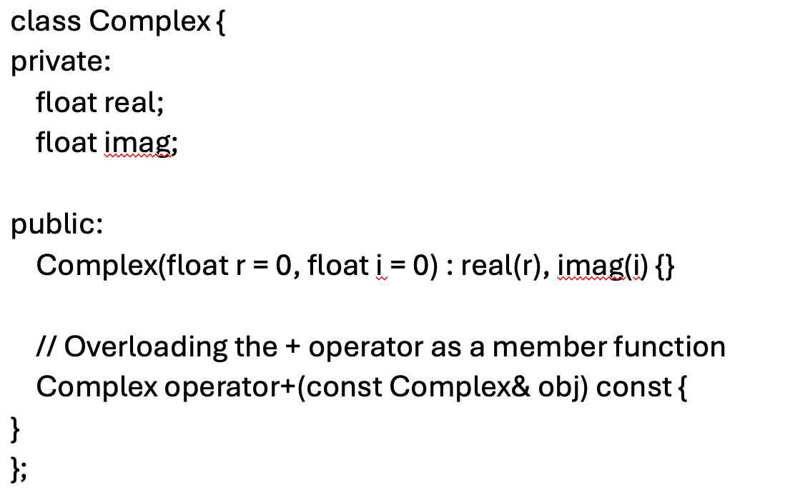
Scenario 1: Operator Overloading as a Member Function

Slide 6
Scenario 2: Operator Overloading as a Non-Member (Global) Function
class Complex {
private:
float real;
float imag;
public:
Complex(float r = 0, float i = 0) : real(r), imag(i) {}
// Declaring the non-member operator+ function as a friend
friend Complex operator+(const Complex& c1, const Complex& c2);
};
// Defining + operator outside the class
Complex operator+(const Complex& c1, const Complex& c2) {
return Complex(c1.real + c2.real, c1.imag + c2.imag);
}

Slide 7
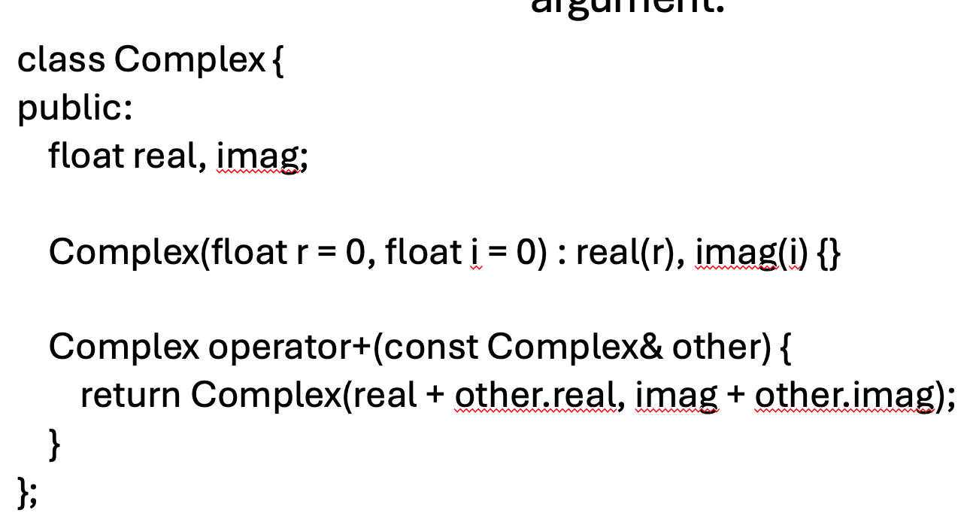
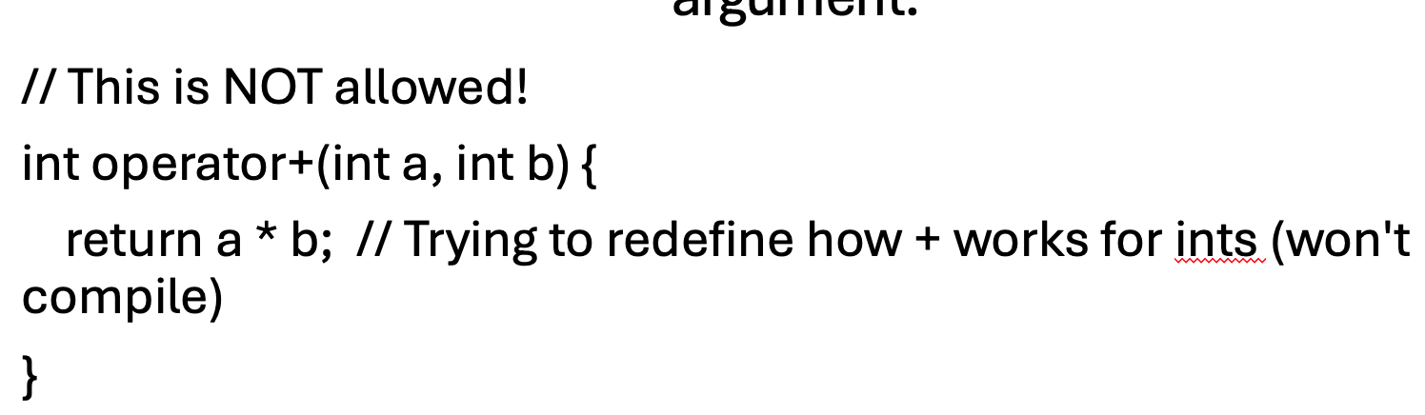
﻿An operator function need not to be a member function, but it must take at least one class argument.
What is allowed:
What is not allowed?
Box operator+(const Box& box, int num) {
return Box(box.length + num);
}
Box operator+(int num, const Box& box) {
return Box(num + box.length);
}

Slide 8
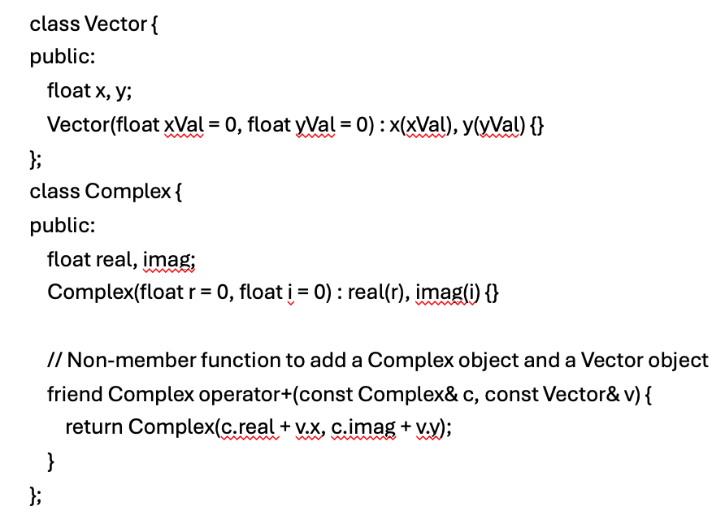
If the first parameter of an overloaded function must be an object of another class, the function MUST be a non-member.

Slide 9
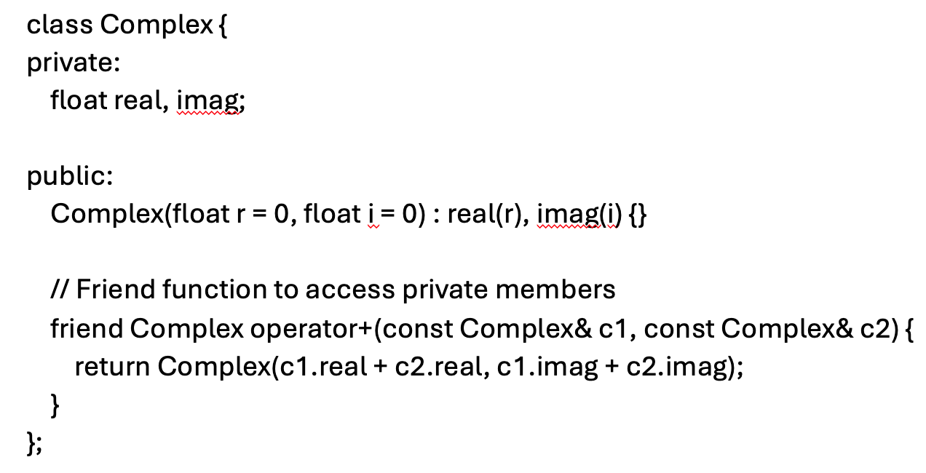
Can Also Be Defined as a Friend

